Slide 1
Optical Sidewalk for Termites
David Holden – Sophomore, Applied Physics/Computer Engineering
Kyron Keelen – Freshman, Applied Physics/Aerospace Engineering
Dr. Willie Rockward – Associate Professor, Physics & Dual Degree Engineering Program
Morehouse College, Atlanta, GA

Slide 2
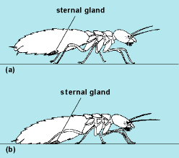
Background
Optics - the scientific study of sight and the behavior of light, or the properties of transmission and deflection of other forms of radiation.
Wavelengths - Forms of electromagnetic radiation like radio waves, light waves or infrared (heat) waves make characteristic patterns as they travel through space
Termites - detritivores, feeding on dead plants and trees, including wood. They are capable of tearing pieces of woody material. Their ability to communicate visually is rudimentary, therefore they use physical and chemical means of communication and maneuvering.
Physical contact with the ground for the termite to communicate and maneuver

Slide 3
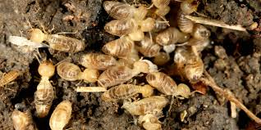
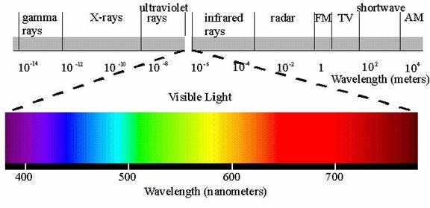
Preliminary Research
Termites preferred the darkness – negative photo-tactic
Termites tended to avoid light equally across the spectrum from short wave lengths (violet 400 nm) to long wave lengths (red 650 nm).
This was not expected due to the fact that many insects have difficulty detected the color red.

Slide 4
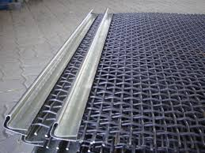
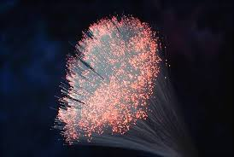
Engineering Project
Fabricate a prototype of an optical mesh that illuminate light to direct path of termites.
Design the optical mesh as an underground pathway/sidewalk that can be implemented in homes, businesses, and other structures, which can direct termites away which will prevent infestation.
Determine which optical wavelengths are best at controlling the termites.
The prototype will utilize the phenomenon of Total Internal Reflection (TIR), where the mesh is made of optical/plastic material instead of metal.
*Wave emitting lights along the solid metal portion (purple line)

Slide 5
References
Giancoli, D. C. (2008). Physics for Scientists & Engineers with Modern Physics.
Naess, R. O. (2001). Optics for Technology Students.
Cabrera, B. J., & Rust, M. K. (1996). Behavioral responses to light and thermal gradients by the western drywood termite (Isoptera: Kalotermitidae).Environmental entomology, 25(2), 436-445
Fei, H., & Henderson, G. (2004). Effects of temperature, directional aspects, light conditions, and termite species on subterranean termite activity (Isoptera: Rhinotermitidae). Environmental entomology, 33(2), 242-248.
http://www.edmundoptics.com/optics/
http://www.orkin.com/termites/

